Slide 1
Time Series Analysis (Air Pollution Forecasting)
Supervised Learning AIML
Modelling Objective:
Our primary objective in this study is to accurately forecast air pollutant levels (that is) of Carbon Monoxide (CO), Hydrocarbons (HC), Nitrogen Dioxide (NO2), Ozone (O3) by extensively exploring univariate and multivariate time series forecasting models
Lim Hur 2112589
DAAA2A02

Slide 2
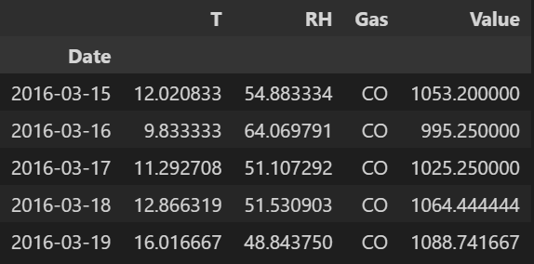
Prediction task and background research
Can we develop a useful tool/asset that will prove useful for relevant health officials by predicting the air pollutant concentrations levels so that we can assist in safeguarding the lives of others by taking preparatory measures beforehand?
Immediate Tasks – Use air-pollution dataset to train a time series model for future air pollution forecasting.
The training dataset is very similar to the UCI repository `Air quality dataset`, which consists of 328 observations from March 2016 to February 2017 with daily average concentrations for Carbon monoxide, Hydrocarbons, Ozone, Nitrogen dioxide (NO2). `Temperature` and `Relative Humidity` recordings are provided as well. Test set, on the other hand consist of 63 observations from February 2017 to April 2017.

Slide 3
Prediction task and background research
If we were to assume that the dataset is similar to the UCI repo, but of different dates, then, we note that the recordings are made using an array of 5 metal oxide chemical sensors embedded in an Air Quality Chemical Multisensor Device.
The sensors used are metal oxide chemical sensors, and when gases are absorbed, there is a reaction that brings about changes in the conductivity. The chemical sensor then uses this reading output to estimate the concentration of the air pollutant. [16]

Slide 4
Understanding the negative health consequences air pollution can bring
Air pollution is contamination of the indoor or outdoor environment by any chemical, physical or biological agent that modifies the natural characteristics of the atmosphere. Pollutants of major public health concerns include carbon monoxide, ozone, nitrogen dioxide, sulfur dioxide and even hydrocarbons. [12]
According to study done by WHO (World Health Organization), almost all of the global population (99%) breathe air that exceeds WHO guideline limits and contains high levels of pollutants, with low income countries suffering from the highest exposures. [12]
With this in mind, air pollution can bring about disastrous consequences towards our health, and to cite some examples, long term health effects include heart disease, lung cancer, and respiratory diseases such as emphysema. Air pollution can also cause long-term damage to people's nerval systems and organs.
On the other hand short term health effects can include bronchitis, severe irritation to nose, throat, etc. [14].
All these consequences results in millions of deaths. Hence we need to recognize the negative consequences of air pollution.

Slide 5
Significance of developing a time series forecasting model
By tapping on time series forecasting models, we can further understand and identify the general direction in which the air pollutants concentration levels are changing. That is, to gain further insights at the same time estimating the impact of air pollution can have.
This can bring about many benefits.
It can help weather forecasting stations make optimal decisions such as issuing a warning message to alert the general public on the potential unhealthy air quality index. [13]
It can assist relevant health authorities or government officials to plan long-term strategies and mitigation measures based on the forecasting prediction concentrations of air pollutants to alleviate the issue.
All these would go a long way in protecting lives, especially so for populations that are very vulnerable (such as infants, the immunocompromised, etc) or populations that are directly succeptible to the grave ramifications of air pollution.
Furthermore, by taking the appropriate prepraratory measures beforehand, countries can also save money as there would be reduced healthcare costs incurred as a result of the health problems as a result of air pollution. Some problems include respiratory infections, heart disease and lung cancer, which can be very costly when many succumb to such health effects.
Clearly, the benefits of taking relevant measures to alleviate air pollution earlier outweighs the negative consequences of air pollution.
Hence, if our model can forecast air pollutant concetration accurately, and after deploying, it can be an indispensable asset for roughly estimating the severity and impacts of air pollution. With such a knowledge, such information can be conveyed to the public for them to be aware of health risks.

Slide 6
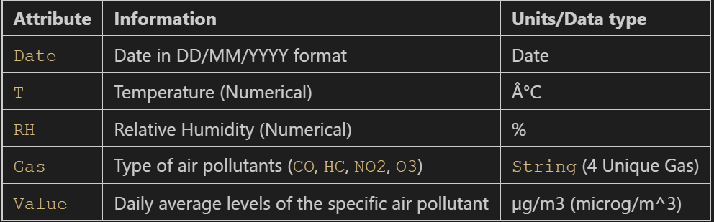
Dataset Info & Prep
Dataset has 1312 rows and 5 columns
Dataset ‘Date’ does not follow the conventional pandas datetime format, we need to manually convert the ‘Date’ attribute to pandas datetime object by using pd.to_datetime, with the parameter %d/%m/%y.
Set datetime to the index, and drop original date column.
As specified by a similar dataset under UCI machine learning repo, missing values should be denoted with -200.
We have both numerical (Value, T, RH) and categorical attributes (gas)
On the right is the data dictionary.

Slide 7
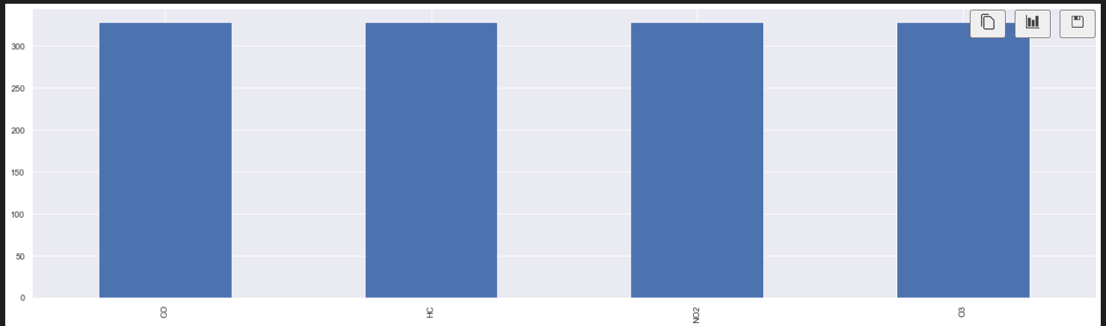
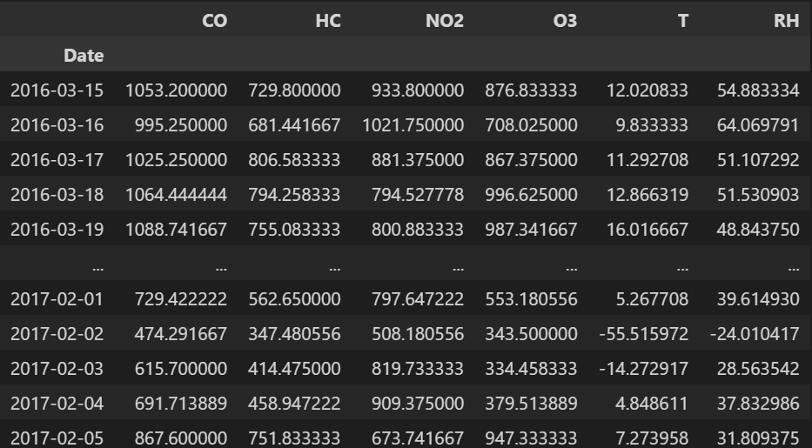
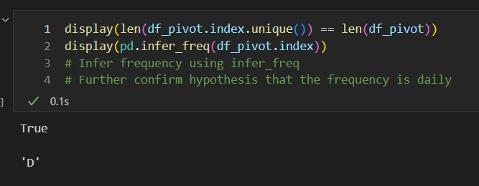
Exploratory Data Analysis
Same counts of gas records in the dataset, hence likely to be aggregated by gas.
Pivot dataset to wide format facilitate EDA and modelling.
Ideally, we have each gas type for each column
Pivoted dataset has 328 rows and 6 columns.
After pivoting we immediately notice the presence of multiple endogenous variables that is the gases.
Exogenous variables are temperatures and relative humidity.
Frequency of the data:
Train data is of daily interval from 2016-03-15 to 2017-02-05. ‘D’ frequency is seen from time series

Slide 8
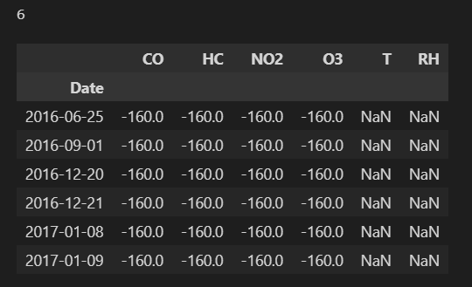
Missing and outlier/impossible value analysis
We can see that we have 6 missing values under `T` and `RH`. (6 days with missing values for `T` and `RH`)
Diving deeper, we see that the missing values occur at random, and we can say that there is no clear pattern among the days with missing values
However, we note that during such days where `RH` and `T` is null, the concentration levels for the air pollutants are the same, which is -160. This is very odd, and the values do not make sense at all, and can be likely data collection error due to chemical sensor failures which resulted in such errorneous values. We recognize such values as impossible values.
As such, it is not logical for the concentration values to possess extreme yet negative values, and we cannot ignore these values.
Next, we need to handle the missing values by imputation and deep dive further.

Slide 9
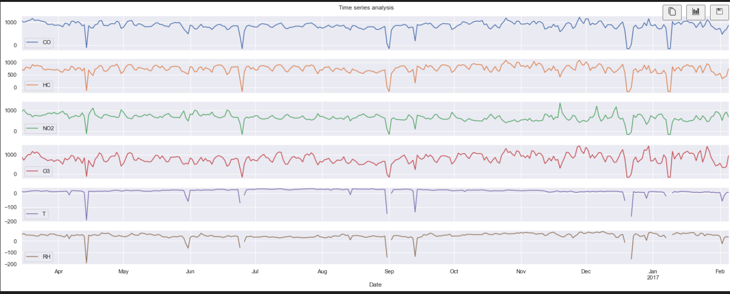
Line graph (Insights)
From the line graph, we can immediately establish several types of problems we need to deal with: outlier values which are also impossible values, and missing values.
> Anomalies observation/impossible values from line graph:
We observe that there are frequent shifts in the data, these extreme negative shift/changes that we are not able to comprehend, can be considered outliers, for all we may know, these values are erroneous. Similarly, these values are very inconsistent with rest of time series, and can drastically affect analysis, and further affecting the forecasting capability of time series models.
One reason for these extreme negative values/shifts can be due to sensors drifting.
Moreover, we immediately notice impossible values and extreme negative outlier value such as temperature of around -190 degree. Next, there are also impossible values such as -191 for relative humidity. This would not make sense as the lowest temperature recorded on earth is -90 deg celcius, while relative humidity recordings would not make sense to be negative. We also notice that there are some days where gases concentrations also have extreme negative values, similar to the gas concentrations on days with missing `T` & `RH` recordings.

Slide 10
Line graph (Insights)
> Missing value observation from line graph:
With regards to the days with missing values, we can see that the days before and after have extreme values such as drastic spikes for `T` and `RH` and other gases. One possible scenario that caused this could be instrumental malfunction or positioning of the sensors under conditions for which they are not designed to. [1]
The spikes could explain the early effects/signs of malfunction, while the missing values denote the removal of sensors from site for fixing.
> General observation made from time series:
Upon further research, a study was conducted to find out if humidity and temperature affected the performance of sensors in recording gas, the results of the study showed that the temperature and humidity affected all the gas sensor response. The magnitude of the sensors responses was observed to decrease with rising temperature and humidity levels [2].
2. This could therefore explain how all the gas have somewhat similar line shapes, in response to rising temperature and humidity levels.
> What to do next?
1. We need to investigate the abnormal values from sensor drifting, handle impossible values, and missing values.

Slide 11
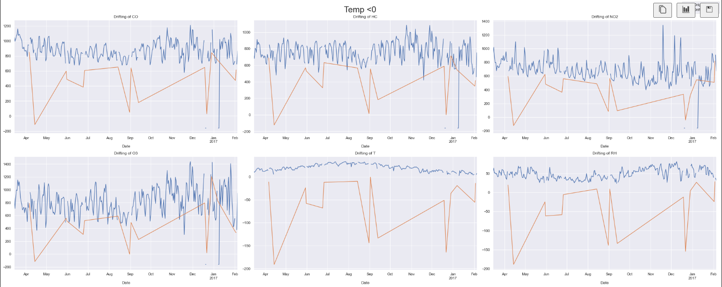
Investigate Sensor drifting/drifted recordings
Evidences of cross-sensitivities as well as both concept and sensor drifts are present as well through research, that can affect sensor concentration estimation capabilities. [15]
Further research suggests that drifting would mean a sudden deviation in the sensor readings due to influences such as temperature fluctuations from the normal range. This leads to a change in the measurements over time leading to inaccurate information. [3]
More specifically, in this scenario when there are abnormal changes in temperature and relative humidity, it causes a change in the resistance of sensors, causing readings to drift. [2]
We will investigate periods where the temperature fluctuates from positive values drastically, that is `T` < 0. This will act as an indicator for anomalies to flag out and to visualise sensor drifting
Furthermore, there are instances where some of the recordings of temperatures deviate from the normal range for some period of time. We need to investigate this thoroughly as it may pose a problem for us
We can see that drifted recordings do not overlap with data, hence it shows the anomaly which is sensor drifting.
One thing to note is that once the sensors drift, all the recordings of the gases will be affected, in a way they are erroneous.
Sensor drifting seems to affect all gas recordings at random periods with no clear pattern.
We will need to handle the drifted recordings which are considered anomalies.
Before drafting a plan to deal with outliers, and anomalies, impossible observations, I want to confirm my speculation by doing other basic EDA.

Slide 12
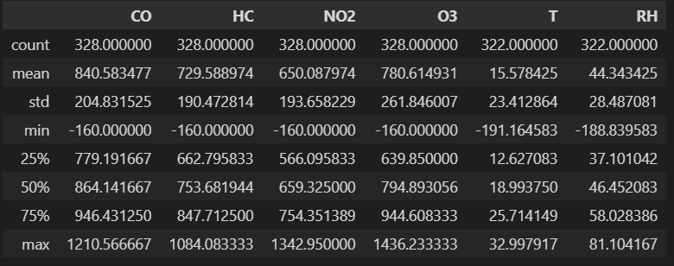
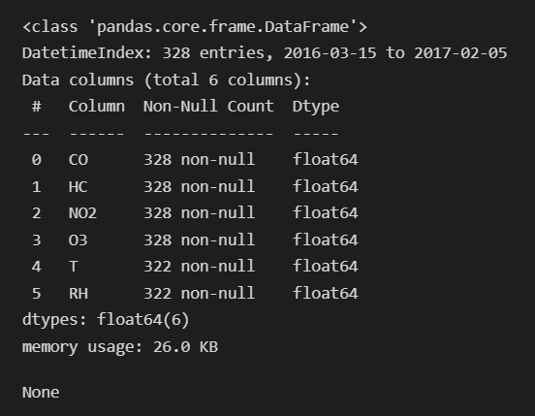
Descriptive Statistics
From the descriptive stats, attributes are of different scale.
Generally, for most of the attributes, there are no extreme positive outliers.
Presense of extreme negative outliers for all attributes. For example, mean relative humidity is 44%, while the minimum is -188%, this is not possible and is probably outlier, which may suggest a negatively skewed distribution due to extreme outliers.

Slide 13
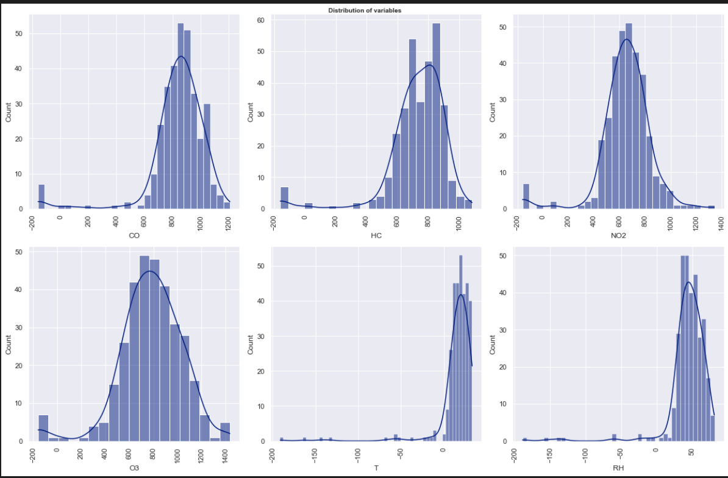
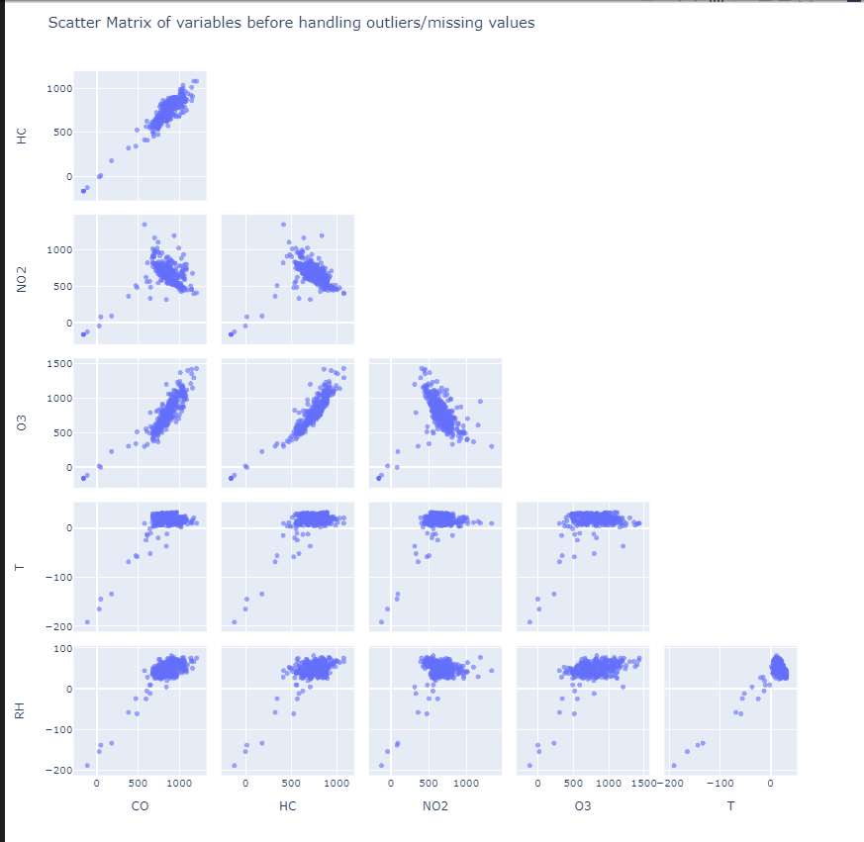
Distribution before handling outlier/impossible value & Relationship between variables
Negatively skewed distribution observed for almost all variables, likely due to the precense of outliers.
Presense of many outliers/impossible values that need to be handled
Not logical/impossible for RH and all concentration of gases to be negative
Impossible for temperature to be so close to -200 degrees, in any case, such extreme temperatures are likely to be extremely inhabitable even for humans.
From scatter matrix:
Many extreme outliers/impossible values that do not follow the general trend of the data
Unable to visualise the general trend of data.
Further highlights the need to analyze and understand further to handle these values

Slide 14
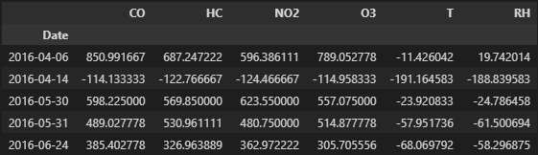
Outlier and anomaly detection
We have come into a conclusion that the extreme negative values in which majority of them can be classified as impossible values are not normal from the analysis above and i will summarise of the possible reasons as below:
- Extreme negative temperature values is too cold which is not appropriate and logical
- RH - Impossible to be negative, as it ranges only from 0 to 100%
- Gases - Can either be missing values/instrumental malfunction (Negative levels of gas concentration estimated by sensor is illogical and impossible)
- Drifted data under temperature which are unreliable
We will now detect outliers/anomalies for any negative values for attributes.
We will detect any drifted data and extreme negative temperature via `T` < 0, and gases < 0, followed by `RH` <0
Next, we can see that we have detected 22 rows with both anomalous values and missing observations, hence we will deep dive deeper to see what we can do about it.

Slide 15
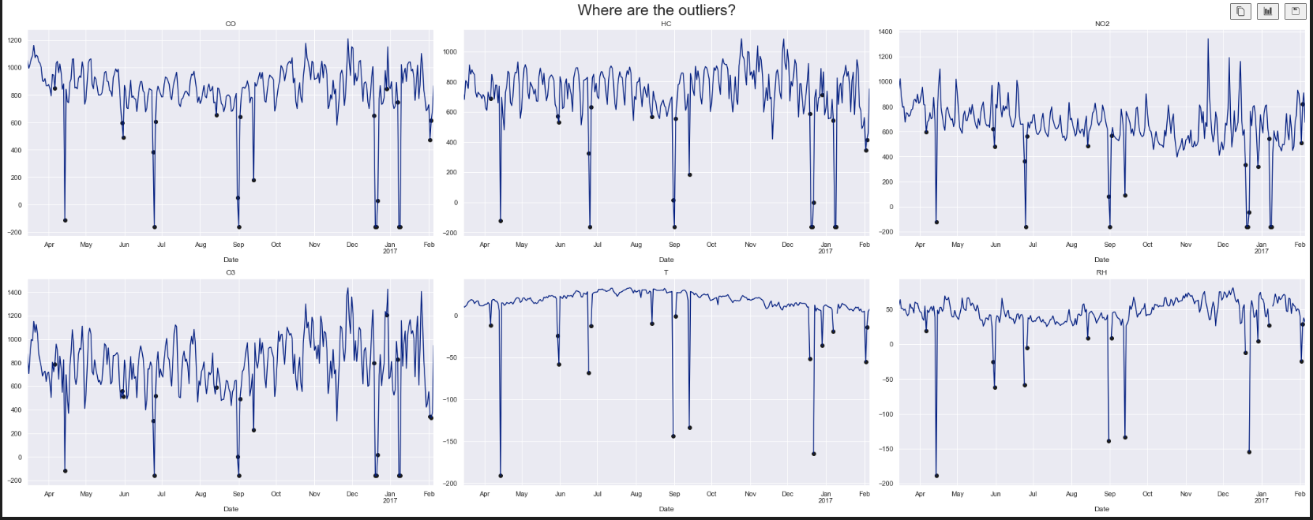
Methods to deal with outliers/impossible and missing values
To visualize anomalies, we plot a line plot. Black dots indicate impossible/errorneous values.
As mentioned, earlier we are facing the problem of having impossible and missing values.
Methodology:
1. We will first clean impossible, drifted and missing values, then further perform time series analysis, to determine if we need to further handle any possible outliers/deviations that would distort the general trend of the data.
We can deal with impossible and missing values by selecting one of the following methods:
- Perform interpolation
- Ignore outliers (not a good idea)
- Forward fill
- Dropping (bad solution as it will disrupt the time series, by creating holes in data, we will end up with sequences with many missing data points.)

Slide 16
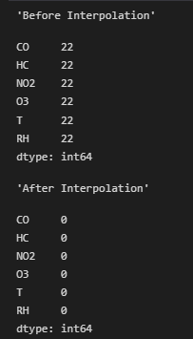
Methods to deal with outliers/impossible and missing values
Finally, we choose interpolation with parameter of method = time.
(Works on daily and higher resolution data to interpolate given length of interval)
There are 22 instances under each variable that has impossible/missing values.
Use interpolate(`method = time`) and `limit_direction = forward`.
This is done as we should not use future values to interpolate past values in time series data.
Moreover, we first set the all the missing and impossible values to null. Directly interpolating the missing values without setting to `np.nan` is not ideal. This is because the previous value may be an impossible or errorneous value. This is why we set everything to np.nan first.

Slide 17
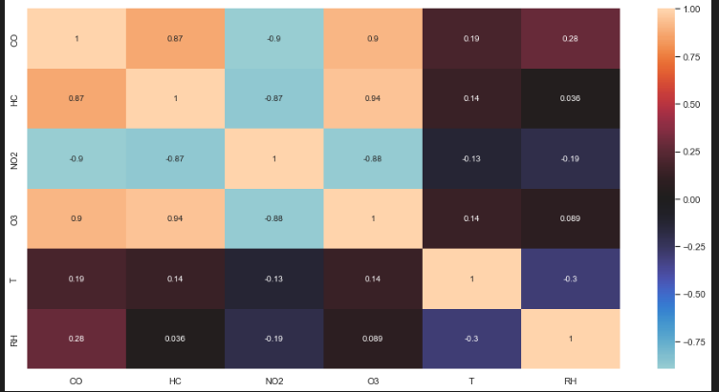
Correlation matrix
Upon further research: We need to be suspicious when we come across time-bound data having multiple variables, as such we need to use the percentage change to calculate the correlation instead.
This is to avoid a phenomenom called spurious relationship, in which two or more variables are associated but not causally related, likely due to unseen factors. In this case, there would be false correlations due to within series dependance.
The problem about spurious correlation is that series can appear correlated, but the correlation itself is not meaningful.
We will use Spearman correlation coefficient, as they are more robust than the Pearson coefficient. Pearson measures linear dependence where Spearman measure are invariant by monotonous transforms of variables.
Using pearson coefficient may likely give us misleading results.
Observe that change in O3 levels are highly correlated with HC with a correlation of 0.94
Gases are generally correlated with very high correlation.
An increase/decrease in concentration of may also lead to increase/decrease in another gas levels as they participate in chemical reactions that can consume or produce the gas
Moreover, Temperature and RH have weak correlation with all the other gases.

Slide 18
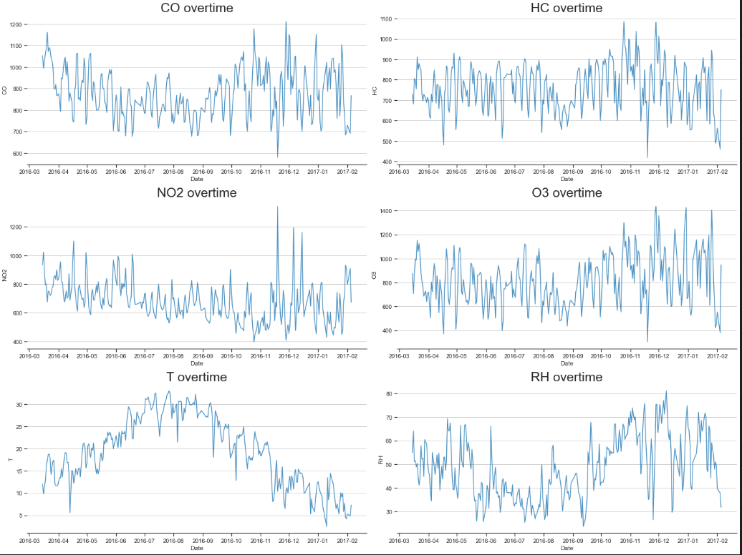
Time series analysis
After interpolation, Trends seems to be more 'smooth' and consistent after handling the outliers, however there are still some instances where the recordings deviate slightly away from the normal trend. However, we will NOT handle or bother these deviations as I want the final model to also be robust in a way that it is familiar with such the trend of such slight deviations. On the other hand, if we carefully clean all the slight anomalies and deviations, this may severely limit the model in predicting outliers and deviations, therefore not generalizing well during model deployment. As such, I WILL leave the data as it is, and will not remove/handle anything else.
Using tukey fences, we can detect the small deviations. We immediately note that the slight deviations for each attribute are normal & logical and we will keep these values to hopefully produce a model that can be robust in a way that it is familiar in predicting and dealing with small outliers, which allows the model to generalize well when deployment.

Slide 19
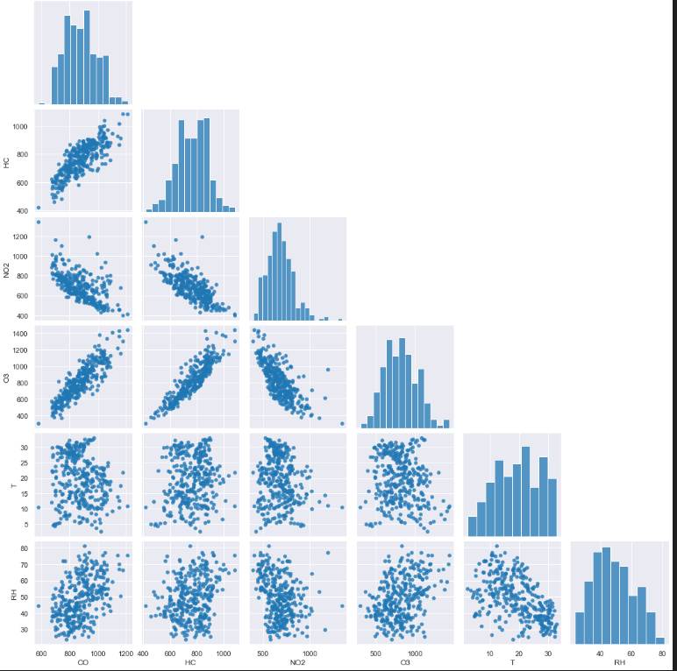
Time series analysis
We note now that after preprocessing, the variables are less skewed. And that the general trend of the data can be observed.
Variables generally follow a near normal distribution.
Prescense of some correlation can be observed between several gases as mentioned earlier.

Slide 20
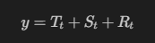
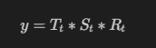
Time series analysis
Decomposing time series into 3 components is crucial to improve forecast accuracy.
The trend of a time series refers to the direction in which the time series is heading. Time series can have a positive/increasing or a negative/decreasing trend, but can also have no trend.
Seasonal - Refers to data that rises and falls (repeated patterns) at consistent frequencies. It could be due to month of the year, day of a month, weekend. In other words, seasonal variation are cycles that repeat regularly over time.
The remainder is whats left of the time series data after removing its trend, cycle, and seasonal components, It is the random fluctuation in the time series data that the above components cannot explain.
To determine if time series is multiplicative/additive, we can look at the variation.
If the magnitude of the seasonal component increases overtime, then the series is multiplicative, else the time series is additive.
Additive decomposition is more appropriate if the magnitude of the seasonal fluctuations, or the variation around the trend-cycle, does not vary with the level of the time series.
Variation in the seasonal pattern, or the variation around the trend-cycle, appears to be proportional to the level of the time series, then a multiplicative decomposition is more appropriate.
Additive(sum) Multiplicative

Slide 21
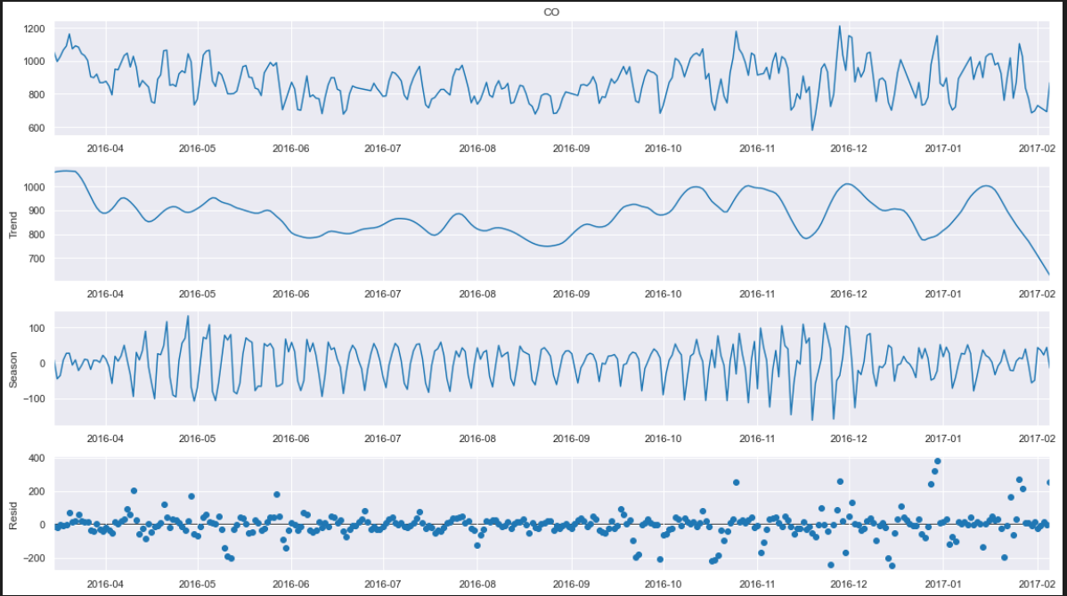
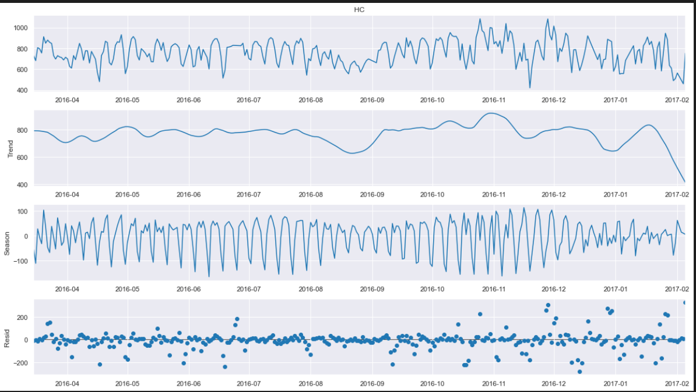
Time series analysis
Since our time series amplitude does not vary overtime for the variables, hence time series is additive.
We will use STL (season trend decomposition using local regression), instead of the naïve implementation of seasonal_decompose.
STL is very versatile and handles any type of seasonality, robust to outlier. One downside is that `STL` only supports additive decomposition which is fine in our case
After decomposition, we can see from CO, It seems that on weekends, the concentration of CO is lesser, this could be logical as during weekends, there might be less commuters going to work as usually people do not work on weekends, hence less vehicular CO emissions, which can explain the lower CO emissions.
Downward trend observed for CO, from April to sept, before changing to upward trend from sept to jan.
Trend for HC seems consistent
Significant seasonality present in the data, that repeats weekly, similar to CO
CO
HC

Slide 22
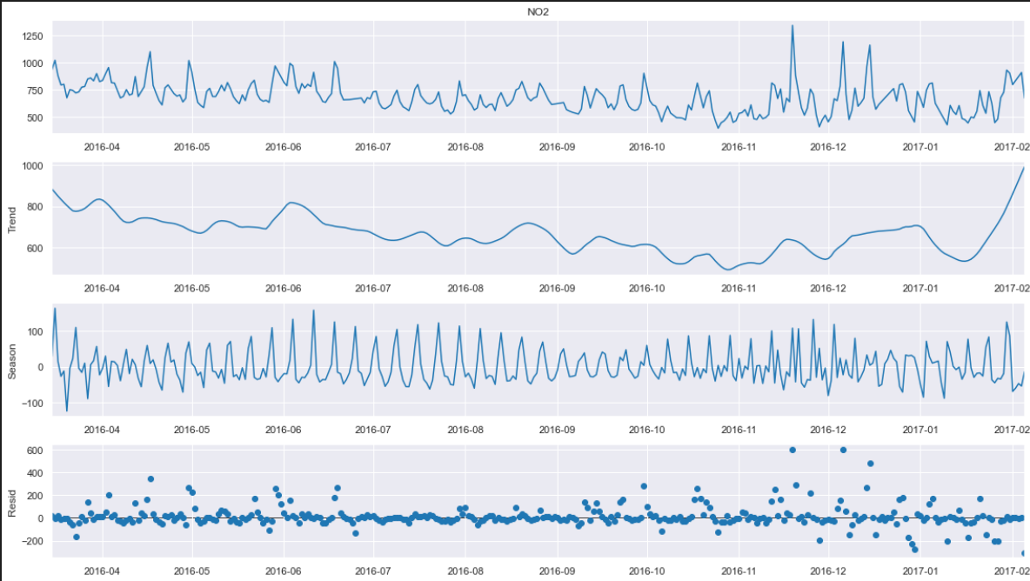
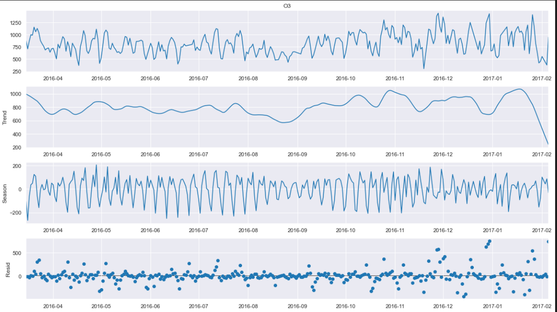
Time series analysis
NO2 Seems to follow a slight downward trend, followed by an upward trend in earlier 2017.
There is a downward trend from april to december 2016, before changing directions to an upward trend from January to february 2017.
Seasonality is present in data, that seems to repeat weekly as well.
One thing to note is that highest levels of Ozone are also the periods in which NO2 levels are the highest (November 2016 to January 2017)
For O3, observe a non linear trend. Trend seems to be consistent, seems to have slight downward trend after 2017 January. Seasonality is present.
Lastly, after seasonal decomposition, we note that Seasonal ARIMA models can be quite appropriate given the seasonal trend of 7 for gases.
Seasonality seems to be similar for the variables, of 7 day period
NO2
O3

Slide 23
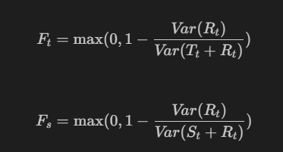
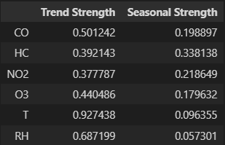
Strength of Seasonality and strength
To determine if seasonal differencing is required.
Trend strength ranges from 0 to 1.
For strongly trended data, the seasonally adjusted data should have much more variation than the remainder component.
Series with seasonal strength F close to 0 exhibits almost no seasonality, while a series with strong seasonality will have F close to 1
Carbon Monoxide has the highest trend strength, while Hydrocarbons have the highest seasonal strength.
- Ozone has the weakest seasonal strength, while Nitrogen dioxide has the weakest trend strength.
- Given this, we need to determine if seasonality differencing is required, seasonal difference is the difference between an observation and the previous observation from the same season.
No seasonal difference needed if F <0.64, otherwise one seasonal difference is suggested.
Source: https://otexts.com/fpp3/stationarity.html

Slide 24
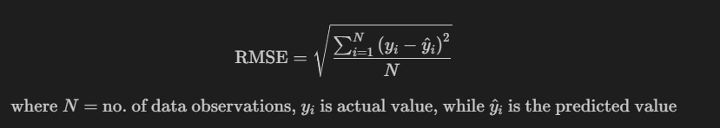
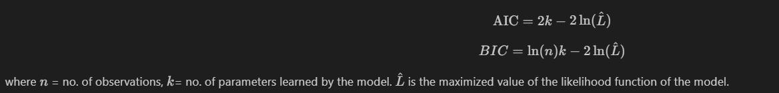
Modelling metrics
Use RMSE, as main metric. (Root of mean squared error)
Easy to interpret
Since our aim is to accurately forecast air pollutant concentration levels, RMSE is better in terms of reflecting model performance in dealing with outliers/ large error values. RMSE tell us how accurate our predictions are and, the amount of deviation from the actual values.
AIC tell us how well the model fits the data without overfitting it. it can be used as a mesaure of the 'goodness' of fit of estimated statistical model. Similarly, BIC can measure the trade-off between model fit and complexity of the model. A lower AIC/BIC indicate better fit. [4]
- Lower AIC and BIC values indicate lower penalty terms which means that the smaller AIC/BIC, indicates a better fit
- Furthermore, in any machine learning/time series model, we want to avoid the problem of multicollinearity, as such we will need to be smart and careful when selecting models. Given this, we need to select models that have lower AIC and BIC. This is because if some models tend to have higher multicollinearity than others, they may tend to have higher AIC and BIC values. It is because under high multicollinearity it is possible to build a parsimonious model with few parameters that has a fit nearly as good as that of a rich model with many parameters. As such, the parsimonious model will be less prone to multicollinearity than the rich model. [5]

Slide 25
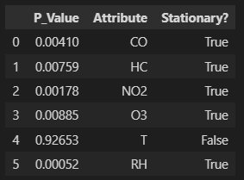
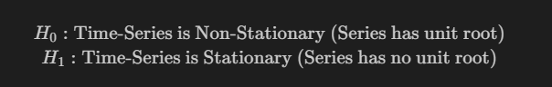
Test for Stationarity
We will need to conduct a series of tests before fitting the models.
These tests are crucial as some of them are used determine the utility of multivariate time series models and stationarity is needed for models like ARMA
We will perform augmented dickey-fuller test to check for stationarity, by using `adfuller` from statsmodels.
It is a type of statistical test aka a unit root test.
Null hypothesis is : Time series is non stationary that is series has unit root
Alt hypothesis is: time series is stationary (series has no unit root.
We will perform augmented dickey fuller test with 0.05 significance level.
1Stationary time series is crucial for modelling most time series models such as ARIMA, and is also required for other statistical tests. For example, we need to check if our data satisfies certain statistical assumptions that may be made by our models like Auto Regressive models. Given this, we require time series to be stationary for forecasting.
To be more specific, for instance, since ARMA models looks at the past data to predict the future values, It appears that any stationary data can be approximated with stationary ARMA model , and hence this is why we need to ensure time series is stationary. Hence, the concept of stationarity is very important in modelling non-independant data.
To put it simply a stationary time series is one in which the properties - mean, variance and covariance do not vary with time.
Null hypothesis rejected for all gases, even RH.
- All time series except `Temperature` is not stationary.
- We can see that all gases have strong stationary, having p values of less then 0.05, hence we do not need to transform or perform differencing to our data, this will mean that if we utilize ARIMA models, we can have an order of (p,0,q), where p and q are to be decided later on, 0 denoting no differencing

Slide 26
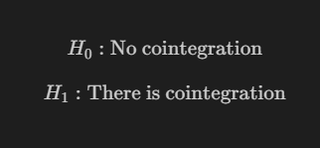
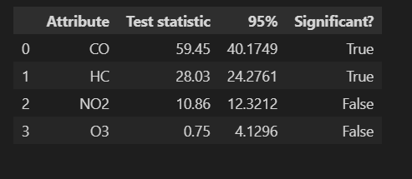
Test for Cointegration
Johansen's test is a way to determine if several time series are cointegrated in the long term, to determine if multivariate modelling is appropriate.
It helps to establish the presence of a statistically significant connection between two or more time series. Cointegration is a statistical property of two or more time-series variables which indicates if a linear combination of the variables is stationary.
When two or more time series are cointegrated, it means they have a long run, statistically significant relationship.
This is the basic premise on which Vector Autoregression(VAR) models is based on, assuming that predicted values have a long running statistical significant relationship. Hence, we need to perform the cointegration test before starting to build VAR models.
At least 2 time series have significant cointegration.
Proceed with causation test

Slide 27
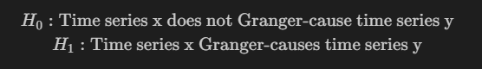
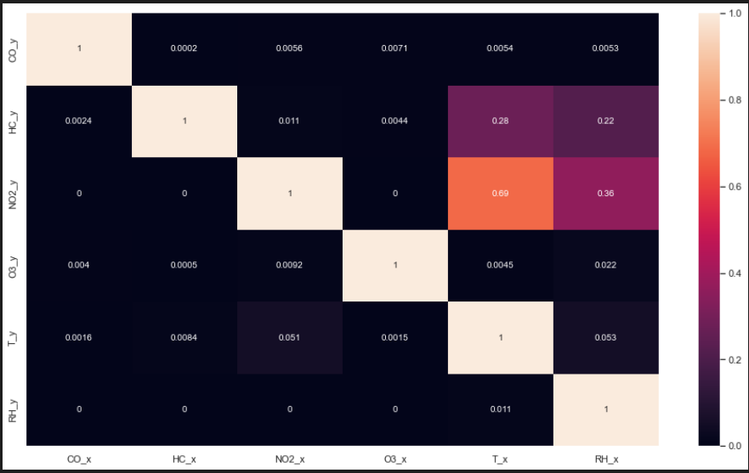
Test for causation
Vector Autoregression `(VAR/ VARMAX)` models works on the assumption that the predicted variables influences each other. To test if the variables do indeed affect each other. We carry out the test for causation.
The Granger causality test is a statistical hypothesis test for determining whether one time series is useful in forecasting another in multivariate time series data, (that is to check if time series influences one another).
One requirement for granger causality test is for the data to be stationarity, as seen above, we have passed the stationarity test.
We want to have some causation between the time series, so we can implement multivariate time series modelling.
If some pvalue < significance level =0.05, we reject null hypothesis.
Hence there is sufficient evidence to conclude multivariate time series modelling is relevant
Rather than testing whether Y causes X, the Granger causality tests whether Y forecasts X
We will perform Granger’s Causality test for all possible combinations of each time series.

Slide 28
Test for causation
From the matrix, we note that columns are predictor variables, while columns, Y is the response variables
- There is generally causation between the variables, where temperature and relative humidity can explain all the gases except Hydrocarbons and Nitrogen dioxide.
- There is generally causation between gases, given the p values of < significance level of 0.05, hence we can safely reject the null hypothesis.
- We can conclude that the time series in the system are generally interchangeably causing each other. This makes the system of multi-time series a good candidate for using VAR models for forecasting.
- Some variable pairs do not have a p-value of less than 0.05. For example, T and NO2, RH and NO2, T and HC as well as RH and HC.
We also note that we do not require all variables to be interchangeably causing one another to implement multivaiate modelling
From all the tests, multivariate modelling is appropriate, and differencing is not needed.

Slide 29
Evaluation method
Cant rely on hold out test set to evaluate model, as it may not fully indicate the model ability to generalize well.
We want to pick a useful yet robust model that possess low rmse scores, we have to use an unbiased model selection technique, so that we can have robust and reliable measurements of the model performance, and further understand its general potential.
Hence, we will perform time series cross validation, it helps us to obtain an unbiased estimate of true error made by model.
However, we cannot apply a random selection to obtain multiple CV sets, doing this we will end up with sequences with many missing instances and the results will not be meaningful. On non time series data, there is no dependance from one observation to another. This however is not the case for time series data.
- Hence, cannot use the normal K-Fold cross validation for time series, due to the time dependancy factor in our data. These methods assume that there is no relationship between the observations. Instead, we can consider several methods to split up the data, maintaining the temporal order in which the values were observed. We can consider the time series splitter, or blocked cross validation approach to perform cross validated scoring on models. Whatever it is, extra care needs to be taken to avoid data leakage

Slide 30
What to use?
Blocked cross-validation:
- Blocked cross-validation works by adding margins at two positions. The first is between the training and validation folds in order to prevent the model from observing lag values which are used twice, once as an estimator (regressor) and another as a response. The second is between the folds used at each iteration in order to prevent the model from memorizing patterns from one iteration to the next. However, due to the small size of the dataset, the size of train set in each CV iteration would be very small too, (recordings for less than a year), in such a scenario we will prefer the `TimeSeriesSplit`
TimeSeriesSplit:
- Another way to tackle this problem is through training and evaluating the model multiple time each with different window of dataset
Do this via TimeSeriesSplit, to aid us by providing train/test indices to split time series data samples that are observed at fixed time intervals, in train/CV sets.
The idea for time series split is to split the training set into two folds (training & CV) at each iteration such that that the validation set is always ahead of the training set.
- Hence, we will weight the pros and cons of `BlockingTimeSeriesSplit` vs `TimeSeriesSplit`, while keeping in mind the small dataset size. We also need to keep into mind the cross validation method has to evaluate the utility models based on its ability to generalize and its robustness.

Slide 31
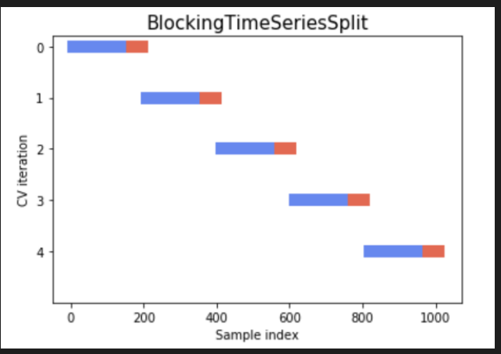
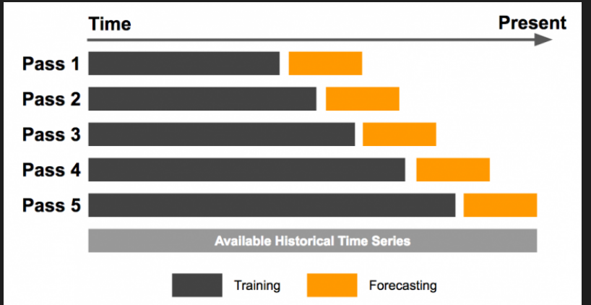
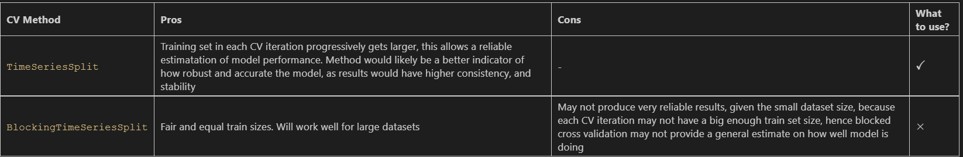
2 main ways for us to perform TS cross validation

Slide 32
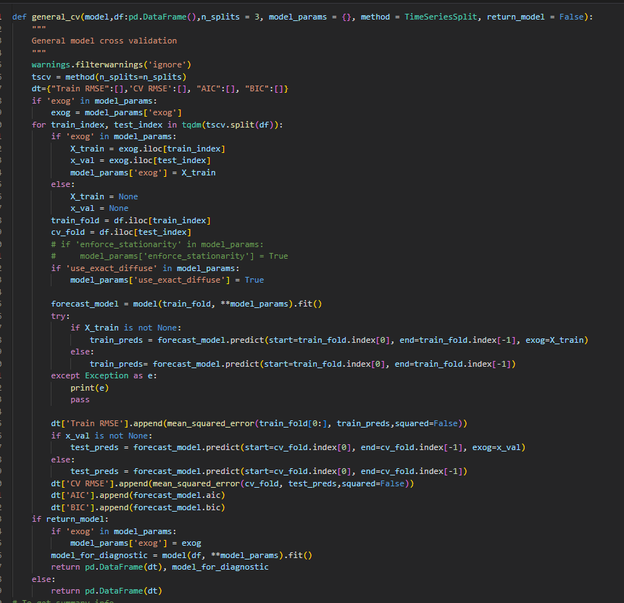
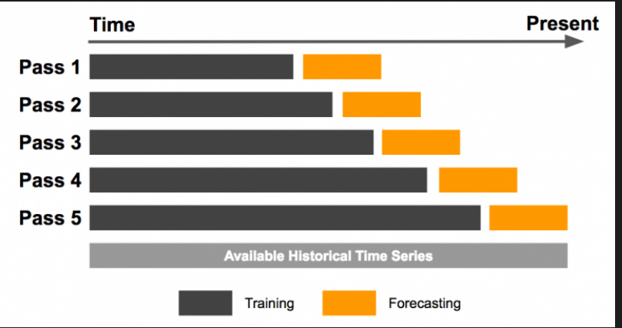
Final evaluation method
After much consideration, we will go with the `Expanding Window` approach via sklearn's time series split. Due to the smaller dataset size of 328 days, I deemed that the expanding window approach/cross-validation to be the most appropriate in this scenario. N_splits = 3

Slide 33
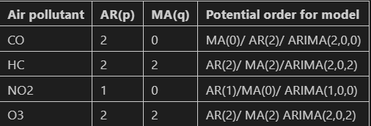
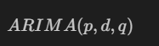
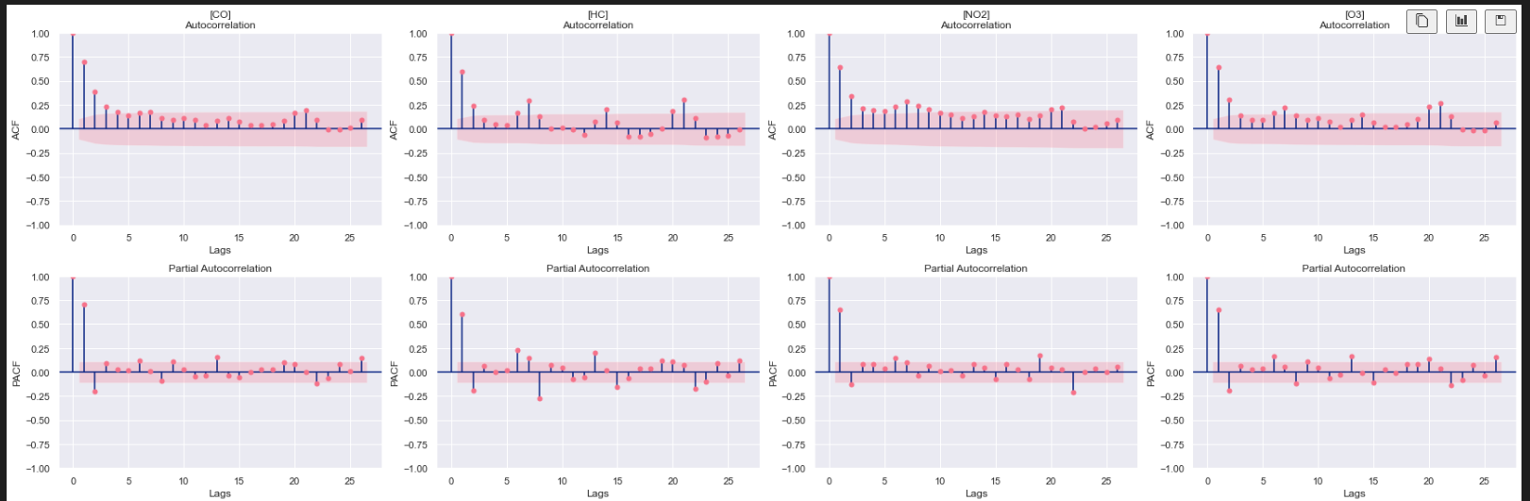
PACF & ACF
Plot acf and pacf to have better intuition & understanding for the order parameter for the model, that is the AR and MA terms.
Autocorrelation: explains how the present value of a given time series is correlated with the past (1-unit past, 2-unit past,..) values. It gives us values of auto-correlation of the series with its lagged values. It can tell us if the observed time series is white noise/random
Partial Autocorrelation: explains the partial correlation between the series and lags itself, that is it describes the similarity between time series and lagged version, without accounting the mutual relationship with other variables that is (partialling out the intervening correlations with other variables.)
Both of these plots can give us a sense on how previous value can be helpful in predicting current value
We need to look out for lags where coefficient is significantly different from 0, beyond the confidence bound.
Note that d = 0, as no differencing is done.
Note an exponential decay for CO, hence
Order will be (p,0,0)
Similarly, for NO2 , ACF shows sinusoidal, hence
Order will be (p,0,0)

Slide 34
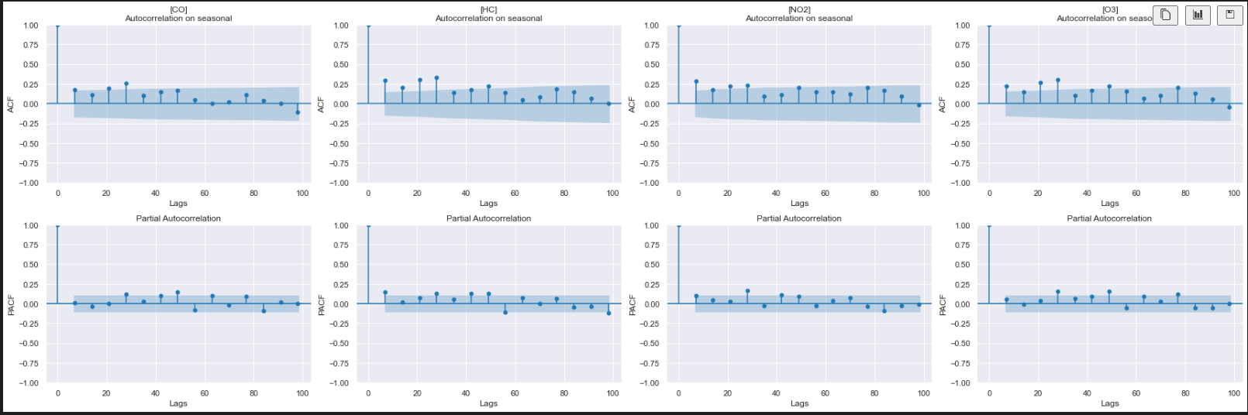
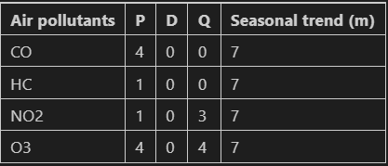
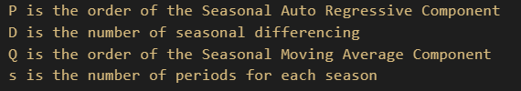
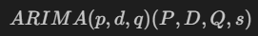
PACF & ACF (Seasonal Order)
The seasonal part of the model consists of terms that are similar to the non-seasonal components (normal `order` parameter) of the model, but involve backshifts of the seasonal period.
- We can use ACF/PACF to detect the seasonal order through the seasonal lags, hence we need to pay close attention to seasonal lags.
More importantly, we need to pay attention to significant lag spikes, and decay in seasonal lags.
We note that earlier through Season-Trend decomposition using LOESS and PACF, ACF plots, the seasonal period is 7.
With the seasonal orders, and the normal orders, we can now
We note that there is a clear exponential decay for CO, in ACF plot, hence it will take on (P,0,0,7)

Slide 35
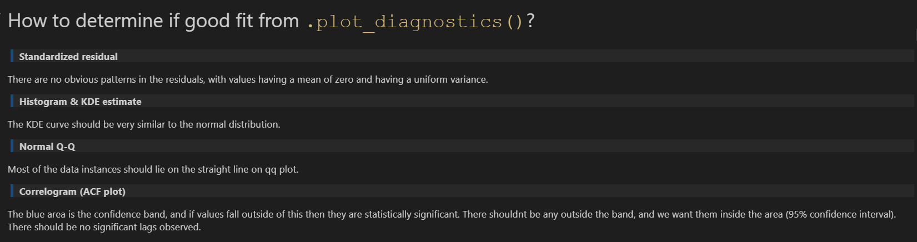

Model selection
Perform 8:2 ratio split on train set , so as to better optimize model, and so we can use the 20% that acts as unseen data to have unbiased evaluation of model

Slide 36
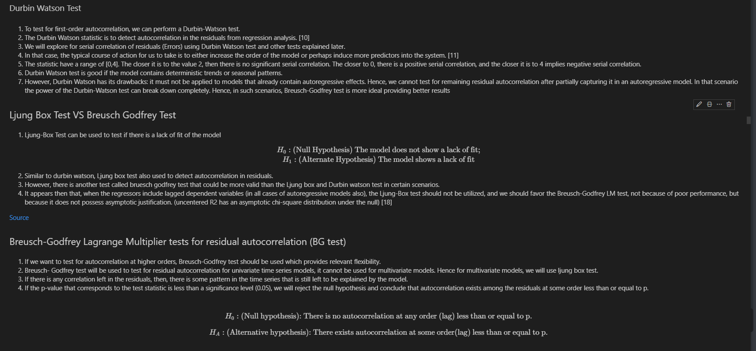
Model selection
Hence, for models that have autoregressive effects, instead of using Durbin Watson, I will use the Breusch Godfrey test instead to check for serial correlation.
For multivariate models, we will use back the Ljung Box test, as BG test don’t work for multivariate models.

Slide 37
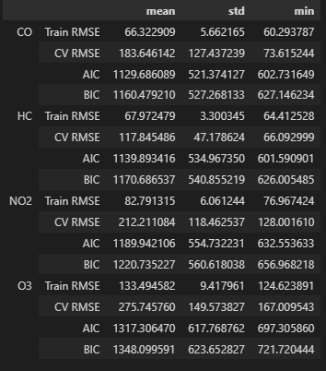
Holt-Winters Exponential Smoothing (triple exponential smoothing)
Forecasts produced using exponential smoothing are weighted averages of past observations, with the weights decaying exponentially method as the observations get older.
Set periods = ‘7’ (seen from STL) and perform cross validation.
Does not severely overfit, given the moderate gap between train and cv rmse for most gases. Performs worst for O3 (Ozone), with cross validated rmse of over 250+. We note that the exponential smoothing model performs well for gases like Hydrocarbons and carbon monoxide, with very decent mean CV rmse scores of 117 and 183 respectively. Smaller difference between train rmse and cv rmse suggest that model does not severely overfit.
High standard deviations for `O3 and CO CV rmse (in the hundreds), suggesting that error rates varies significantly across the iterations which may not be a very good thing. This suggest that HWES is not able to produce consistent results.
Low AIC/BIC –Good fit

Slide 38
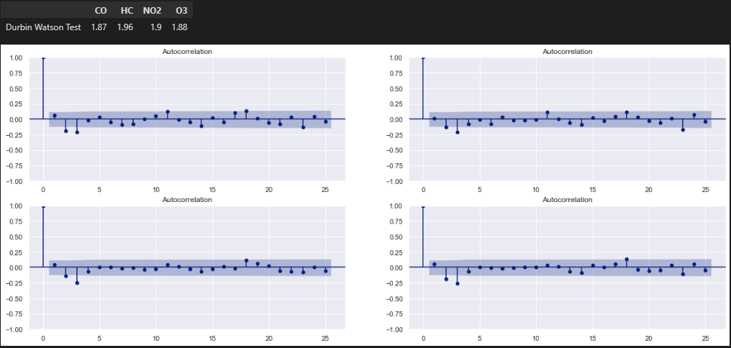

Holt-Winters Exponential Smoothing (triple exponential smoothing)
Generally very little leftovers and correlation can be seen in residuals, suggesting a decent fit. However, From the PACF plot, we can see that there are still valuable information leftover in residuals, that means the model does not account for some information, suggesting that the forecast predictions can still be improved further. This can be seen in some of the significant lags
Durbin watson tests for all air pollutants `[1.87 1.96 1.9 1.88]` show test statistic of somewhat close to 2, indicating less significant serial correlation among residuals.
Residuals are homoscedastic, in which the variance of residual in a regression model is constant.
An improvement step we could take for model improvement is to possibly try to change to a different `initialization method`, that is to change the method for initializing the recursions.

Slide 39
ARIMA (Auto Regressive Integrated Moving Average)
AR (Autoregressive) and MA (Moving Average) and integrated(differencing) components combined
- ARIMA model is a combination of a number of differences already applied on the model in order to make it stationary, the number of previous lags along with residuals errors in order to forecast future values.
AR(p) is autoregressive component of the ARima model, with the p parameter determining the number of lagged series that we use. MA (q) is moving average model where it uses past forecast errors in a regression-like model. `q` is the number of lagged forecasting error terms in the prediction.
Use of the the order parameters we discovered just now from acf and pacf plots for arima model. We do this by specifying the order parameter. However, we set the d =0 as differencing is not done.

Slide 40

ARIMA (Auto Regressive Integrated Moving Average)
We note that ARIMA clearly outperforms exponential smoothing for all gases, given its lower CV and train rmse for all gases
3. Train RMSE scores are hovering around 70 to 130, while cv rmse scores are generally below 200 for the gases. We have a rough idea that ARIMA clearly outperforms Exponential Smoothing.
4. However, there is a higher rmse for O3 than other gases for both train and cross validation sets.
3. Similar AIC and BIC for all gases to that of exponential smoothing suggest good fit of model.
4. However, further action may be taken to further reduce the overfitting. This is because we note a somewhat moderate difference between train rmse and cv rmse.
5. After conducting the Breush godfrey test, and looking at the P values, p values for the models for each gas are [0.029608 0.0 0.000099 0.0006817] which are all below the significance level of 0.05, suggesting that there is sufficient evidence to reject null hypothesis, meaning that we can conclude that significant autocorrelation exists among the residuals at some order less than p or equal to p. Hence residuals are not independant, suggesting not a good fit.

Slide 41




ARIMA (Auto Regressive Integrated Moving Average)
Significant lag at lag = 7 for all air pollutants as seen from correlogram, hence ARIMA fails to capture weekly seasonality pattern, therefore we will try seasonal arima/ucm models later on. Moreover, there seems to be significant lag at lag=3 for No2 and O3,HC models. This is consistent with with the Bruesch Godfrey test we conducted just now, of having some autocorrelation among residuals.
From QQ plot, the residuals are not very normally distributed except for HC, where residual are normally distributed given that the points are close to the line.

Slide 42
SARIMA (Seasonal ARIMA)
Seasonality is a component that tells us the fluctuations are occurring repeatedly for similar periods. Understanding seasonality can improve the forecasting results. In this case, the time series may tend to have seasonal pattern, instantiating seasonal order helps the model to better predict the concentrations, and hopefully better at capturing the general trend of movement for data.
A seasonal ARIMA model is formed by including additional seasonal order terms in ARIMA via statsmodels, more specifically the seasonal_order` parameter
Using the seasonal orders and normal orders parameters detected by PACF and ACF just now, we will now test the SARIMA model

Slide 43

SARIMA (Seasonal ARIMA)
We notice that NO2 is the only gas that has improved forecasts over the ARIMA model, with average cv rmse of 143 with arima, and 111 cv rmse with SARIMA. For the other gases, there is no significant improvement observed.
RMSE scores now hover over the mid 100s to 200 range, for both train and cv, suggesting that our model may need more improvement.
Small gap between train and cv rmse suggest slight overfitting for all gases. However, ARIMA still overfits more than SARIMA given the larger gap between cv and train rmse.
After conducting the BG test, we can see that the p value for CO, HC NO2 are above the significance level of .05. Hence we would have insufficient evidence to reject null hypothesis of independantly distributed residuals, suggesting that there is no significant autocorrelation at any order less than equal to p. SARIMA provides good fit. However, p value of O3 is 0.02. Hence, there is sufficient evidence reject null hypothesis, Meaning that there exists autocorrelation among the residuals (not independant) at some order less than p or equal p. Hence, we can conclude that SARIMA is a good fit for CO, HC and NO2, but not O3.

Slide 44




SARIMA (Seasonal ARIMA)
The gas residuals are generally normally distributed except for CO, given that the points are close to the straight line under qq plot
Significant lag observed at lag =3 for O3.

Slide 45

ARIMAX (ARIMA with exogenous variables)
We are able to take into account the exogenous regressors, that is in thia case is `Temperature` and `Relative Humidity`. This allows for us to provide more information towards model.
This means that the level of temperature and RH could provide a good estimation for the direction or level of air pollutants
By comparing ARIMA and ARIMAX, we notice that ARIMAX outperforms every gas except O3 and HC in terms of average CV rmse scores. However, we also note that ARIMAX has resulted in more overfitting for some models for the gas such as O3 and CO, given its larger gap between cv and train mean rmse scores.
Similar AIC & BIC values with ARIMA models, which is quite low suggesting that the models are not too complicated at the expense of performance.
Similar to ARIMA, the Breusch Godfrey test produces similar results, looking at the P values, p values for each gas are all close to 0, which are all below the significance level of 0.05, suggesting that there is enough evidence to reject null hypothesis of independantly distributed residuals, meaning that there exists some autocorrelation among residuals at some order less than p. This is likely due to the significant lag at lag = 7.

Slide 46




ARIMAX (ARIMA with exogenous variables)
Similar to ARIMA, significant lag at lag=7 observed from correlogram for all air pollutants, hence ARIMAX fails to capture weekly seasonality pattern.
Residuals seems to be homoskedastic, where residual in a regression model is constant.
Residuals from models seems to be normally distributed for all gases, except for NO2. (close to straight line in QQ plot)
Generally, the models coefficients are significant

Slide 47

SARIMAX (Seasonal ARIMA with exog)
Immediately notice that SARIMAX performs the worst for O3 given its high average cv rmse of over 300, compared to sarima of only 190.
Generally SARIMAX performs better for `HC` and `CO`. We may need to further tune its hyperparameters for the other gases.
We can see that it slightly overfits more than the SARIMA model, given its larger gap between train and cv rmse scores for each gas.
Generally, it seems that SARIMA performs slightly better, however more investigation is needed.
After conducting the Breusch Godfrey test, looking at the P values, p value for O3 are close to 0, which are all below the significance level of 0.05, suggesting that there is enough evidence to reject null hypothesis of independantly distributed residuals, meaning that there exists autocorrelation among residuals at some order less than p. Hence residuals for O3 model are not independant, suggesting not a good fit. This is consistent with what we observed from SARIMA earlier, hence I would like to try UCM models. On the other hand p value for HC and NO2 are above 0.05. hence we would fail to reject the null hypothesis (independently distributed residuals), there is sufficient evidence to conclude that there is no significant autocorrelation at any order less than equal to p. Overall, SARIMAX shows good fit, overall a good candidate

Slide 48




SARIMAX (Seasonal ARIMA with exog)
Residuals seems to be normally distributed given that the points are of close proximity to the qq plot. Correlogram shows significant lag for O3.

Slide 49

UCM (structural time series model
We will try out a unobserved components time series model, with exogenous variables specified by exog parameter. UCM decomposes a time series into trend, seasonal, cyclical, and idiosyncratic components and allows for exogenous variables.
Each component in the model captures some important features of the series dynamics.
Seems inferior to SARIMAX, for HC, NO2 and O2. given its higher average CV RMSE and train RMSE. However, UCM performs better for O3. We also can see that UCM does not severely overfit given its smaller gap between train and CV RMSE.
Has low AIC and BIC which suggest good fit.
After conducting the Breusch Godfrey test, looking at the P values, p value for CO, HC and NO2 are close to 0, which are all below the significance level of 0.05, suggesting that there is enough evidence to reject null hypothesis of independantly distributed residuals, meaning that there exists autocorrelation among residuals at some order less than p. Hence residuals for CO,HC and NO2 models are not independant, suggesting not a good fit. On the other hand p value for O3 are above 0.05. hence we would fail to reject the null hypothesis (independently distributed residuals), we can conclude that there is no significant autocorrelation at any order less than or equal to p for O3 model.

Slide 50




UCM (structural time series model
Significant lag observed at lag =6 for NO2, and lag=3 for HC as seen from correlogram.
Residuals are not normally distributed for CO as seen from histogram and kde plot.

Slide 51
Multivariate modelling
Multivariate time series models such as VARMA are able to capture and describe the dynamic behaviour of multiple time series simultaneously and leverage dependencies across these series for more reliable forecasting results.
Each variable is modelled as a linear combination of past values of itself and the past values of other variables in the system. With multivariate time series forecasting, there are more than one time-dependent variable.
We will incorporate vector autoregressive moving average with exogenous regressors model into this section. I found VARMAX to be pretty appropriate given the tests that we have done, as well as the presence of multivariate endogenous variables. Since we have done the cointegration and granger's causality tests, I have deemed that VARMAX and VAR models to be relevant, where we can conclude that the time series generally influence each other.
Furthermore, each variables depends not only on its past values, but also has some dependency on other variables.
From the causation test, multivariate modelling would be good.

Slide 52

VARMA
VARMA allows us to model the dynamic relationship both between the dependent variables and also between the dependent and independent variables.
The varmax class from statsmodels allows us to specify the types of models like VMA, VAR, VARMA through the `order` argument. We need to define the orders of the autoregressive or moving-average process. (`p`, `q`). Exogenous regressors may or may not be included
Note that we need to allow for more iterations than the default (`maxiter=50`) in order for the likelihood estimation to converge as specified by statsmodels documentation
However, the Breusch Godfrey test cannot be performed for multivariate models, hence we will use ljung box test instead.

Slide 53

VARMA
We can see that VARMA generally outperforms all the models for most gases given its lower average CV RMSE and Train RMSE. This is a good thing.
However, we also notice that varma does not perform the best for O3, with 123 for train rmse, and 199 for cv rmse. Furthermore, inconsistent results is inferred through the larger standard deviation (68) for O3 observed. This means that the CV rmse scores for each iteration varies significantly. We may need to further tune its hyperparameters to maximize its potential.
VARMA Does not severely overfit, given the small difference between average train and cv rmse for all gases, possessing low variance.

Slide 54




VARMA
From the diagnostic plot correlogram, we can see a significant lag at lag =7 for HC, which means that varmax is not able to capture a form of weekly seasonal pattern. Significant lag at lag=2 for NO2 and HC is also observed.
The p-value for all gases [0.92, 0.90, 0.73, 0.77] are above the significance level of 0.05 for the Ljung Box test, hence we would fail to reject the null hypothesis of independently distributed residuals. This confirms that our model doesnt have residuals with significant autocorrelation. This suggests that varmax is a decent fit.

Slide 55

VARMAX
The presence of exogenous variables helped the model tremendously in terms of both train and CV rmses for all gases, it has reduced the variance as well. Exogenous regressors has reduced overfitting as seen from the smaller gap between average train & cv rmse scores. VARMAX has also provided improved forecasts for O3, as seen from average lower CV rmse (186) of among all models. We even observed average CV rmse of below 100, for gases like CO (88).
Average CV rmse of 133 for VARMAX for all gases.
Moreover, for O3, the standard deviation has reduced as compared to VARMA. This is a good thing.
Overall, VARMAX provides robust forecasts, possessing low variance. As well as having excellent CV RMSE.

Slide 56




VARMAX
From the diagnostic plot correlogram, there seems to also be a significant lag at lag = 7 for HC and No2. VARMAX is not able to capture some form of weekly seasonality, similar to VARMA.
The p-value for all gases [0.70, 0.89, 0.80, 0.91 ] are above the significance level of 0.05 for the Ljung Box test, hence we would fail to reject the null hypothesis of independently distributed residuals. This confirms that our model doesnt have residuals with significant autocorrelation. This suggests that varmax is a decent fit.

Slide 57

Final Evaluation
Comparing the univariate models, ARIMA (ARIMA/ARIMAX) related models completely outperform smoothing models in terms of train and CV rmse for all gases. Exponential smoothing model also overfits more. High standard deviations for CV rmse across most gases suggest that HWES is not able to produce consistent results, hence an unstable model. Hence, Exponential Smoothing models are out of the question.
3. Among other univariate models, SARIMAX and UnobservedComponents does not perform very well on first sight, this is because we have not properly optimized all the important hyperparameters. There are also plenty of hyperparameters for us to tune, hence this means there is still much room for improvement.
SARIMA performs the best for O3 with average cv rmse of 190, while ARIMAX performs the best for NO2 (average cv rmse of 132). Lastly, ARIMA outperforms all univariate models for CO (average cv rmse of 121) and HC (average cv rmse of 115).
However recall that through the Bruesch Godfrey test we conducted, we have concluded that for ARIMA and ARIMAX was not able to capture weekly seasonality, and there was sufficient evidence to conclude there exists autocorrelation among the residuals at some order up to lag p. Hence we are still unsure which model would be the most optimal in terms of performance and good fit. Let's move on to multivariate models.

Slide 58
Final Evaluation
Multivariate Modelling:
1. We immediately notice that VARMAX outperforms every model given its low train and cross validated rmse for all gases. We also conclude that VARMAX does not severely overfit, possessing low variance, given its small gap and deviation between cv and rmse scores. It also outperforms VARMA. Moreover, the standard deviations for CV RMSE is also lesser for each iteration, suggest that VARMAX is able to produce consistent results
Furthermore, for VARMAX there is evidence to conclude that that there is no significant autocorrelation in the residuals for all the gas from the statistical tests, suggest good fit. Hence, with low bias, and variance, along with good fit, multivariate models are a good candidate.
We also can conclude that exogenous regressors are helpful for improving multivariate models.

Slide 59
Shortlisted models:
When we were performing model selection, we want to shortlist a few model categories, that are SARIMA,SARIMAX, VARMAX and lastly UnobservedComponents.
- We will perform grid search with expanding window cross validation to try and maximize its potential
Why will I not continue to improve other models?
- I chose not to tune Exponential Smoothing because they may not be robust to predicting for outlier values
- For VARMA, VARMAX outperforms VARMA hence, we will just use VARMAX to tune.
- For ARIMA, and ARIMAX, we will not further tune them as we observe from the correlogram that they are not able to capture weekly seasonality. Furthermore, models like VARMAX, which is a generalized version of the ARMA model to forecast multiple time series clearly outperforms ARIMA and ARIMAX. Next, the breusch godfrey test we conducted showed that there exists significant correlation for ARIMA and ARIMAX among some order, which is likely due to the significant lag at 7, this suggests not good fit.

Slide 60


Hyperparameter tuning
Find best set of parameters to maximize model potential
Use gridsearch with cross validation. We will also perform feature engineering to see if further model improvement can be done.
We will tune SARIMA and SARIMAX from (0,0,0)(0,0,0,0) to (3,0,3)(3,0,3,7)
SARIMAX best params
SARIMA Best Parameters
SARIMAX performs the worst for O3, with a average cv rmse of 242. However, SARIMAX performs well for CO HC and NO2.
- Severely overfits for O3 gas, given the large gap between train and CV rmse.
- SARIMA overfits for CO and O3, given the larger deviated train and CV rmse scores.
- We also note that using the best params after hyperparameter tuning did not help for O3 gas.

Slide 61

Hyperparameter tuning
UCM does not overfit as much as SARIMAX models.
Tune autoregressive parameter from 1-7
UCM Best Parameters

Slide 62




Hyperparameter tuning
Need to be extremely careful when tuning the VARMAX order parameter. According to statsmodel doc, although the model allows estimating VARMA(p,q) specifications, these models are not identified without additional restrictions on the representation matrices, which are not built-in. Hence, it is recommended that we do not specify (`p`, `q`) as VARMA(p,q) models are not robust. We should only specify p OR q, leaving the other one as 0
VMAX Best Parameters (0,2) is the best
VARX best params
VMA(0,2) the best, given the lowest standard deviations among CV scores. 141 CV RMSE and 84 Train RMSE. It also possess the lowest AIC and BIC, which can be beneficial. Unlike other orders, VMA(0,2) does not severely overfit.

Slide 63

Summary

Slide 64


Model Improvement

Slide 65



Model Improvement

Slide 66

Model Improvement
We note that SARIMAX does not perform very well with the new exogenous, with an average CV RMSE of 170+. and average train rmse of 75. This is worst than the original exog of T and RH only. Hence, we will compare between SARIMAX with original T and RH against VMA(0,2)

Slide 67

Final comparison

Slide 68



Final Evaluation
1. Create new exogenous variables for the test set
2. Model evaluation using independant 20% unseen test set to have an unbiased estimate of the model's performance.
3. Final Model: VMA(0,2) with exogenous regressors, ['T', 'RH', 'is_weekend', 'Dew point']

Slide 69
References:
1. https://www.ncbi.nlm.nih.gov/pmc/articles/PMC5843703/
2. https://iopscience.iop.org/article/10.1088/1757-899X/864/1/012152/pdf
3. https://oizom.com/how-does-air-quality-sensor-calibration-improve-data-accuracy/
4. https://www.sciencedirect.com/topics/pharmacology-toxicology-and-pharmaceutical-science/akaike-information-criterion
5. https://stats.stackexchange.com/questions/278027/multicollinearity-of-lagged-terms-in-arima-model
6. [Seasonal differencing](https://otexts.com/fpp3/stationarity.html)
7. [Seasonal Strength](https://otexts.com/fpp2/seasonal-strength.html)
8. https://timesofindia.indiatimes.com/city/mumbai/high-humidity-worsening-air-pollution-say-experts/articleshow/49940782.cms
9. https://otexts.com/fpp2/components.html
10. https://corporatefinanceinstitute.com/resources/knowledge/other/durbin-watson-statistic/
11. https://www.statology.org/durbin-watson-test-python/
12. https://www.who.int/health-topics/air-pollution#tab=tab_1
13. https://pestleanalysis.com/time-series-analysis/#Benefits_of_Time_Series_Analysis
14. https://education.nationalgeographic.org/resource/air-pollution
15. De Vito et al., Sens. And Act. B, Vol. 129,2,2008.
16. https://www.sciencedirect.com/science/article/abs/pii/S0925400507007691?via%3Dihub
17. https://www.nature.com/articles/s41598-020-71338-7#:~:text=Temperature%2C%20relative%20humidity%2C%20and%20atmospheric,the%20decrease%20in%20relative%20humidity.
18. https://stats.stackexchange.com/questions/148004/testing-for-autocorrelation-ljung-box-versus-breusch-godfrey

